Slide 1
Virtual Conference for data professionals

Slide 2


Automating Common DBA Tasks with PowerShell
Rob Sewell
Beard Twizzler
rob@sewells-consulting.co.uk
twitter.com/SqlDbaWithBeard
linkedin.com/in/robsewellsqldba
blog.robsewell.com

Slide 3
Automating Common DBA Tasks with PowerShell
Once was a Production SQL DBA interested in PaaS (PowerShell, Automation, Azure and SQL)
Now just helps People and Businesses provide value by providing Training, Automation, Dev Ops and Migration support.
Proud Data and PowerShell community supporter
Rob Sewell
Beard Twizzler
rob@sewells-consulting.co.uk
twitter.com/SqlDbaWithBeard
linkedin.com/in/robsewellsqldba
blog.robsewell.com
Notes:
OBS:SpeakerCircleandSide

Slide 4
Automating Common DBA Tasks with PowerShell
Rob Sewell
Beard Twizzler
rob@sewells-consulting.co.uk
twitter.com/SqlDbaWithBeard
linkedin.com/in/robsewellsqldba
blog.robsewell.com
Notes:
OBS:SpeakerCircleandSide

Slide 5

What is dbatools? – basically
Notes:
OBS:SpeakerCircle

Slide 6


























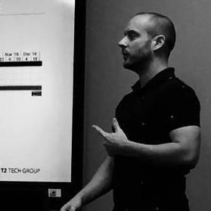











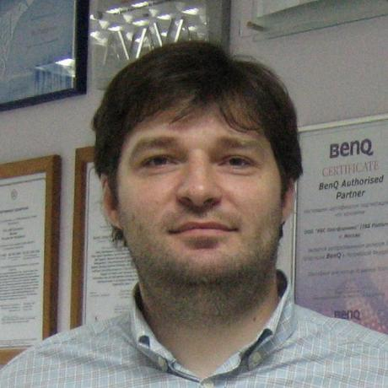






07/2014
06/2016
32 Contributors
Published to GitHub & ScriptCenter
SQL Community Slack Was Born
03/2018
11/2019
MIT Licence
07/2014
06/2016
01/2017
06/2019
Need to Migrate Sharepoint databases
First Community Contributions
The Road to 1.0 starts
Dbatools 1.0
Notes:
OBS:SpeakerTinySquare

Slide 7
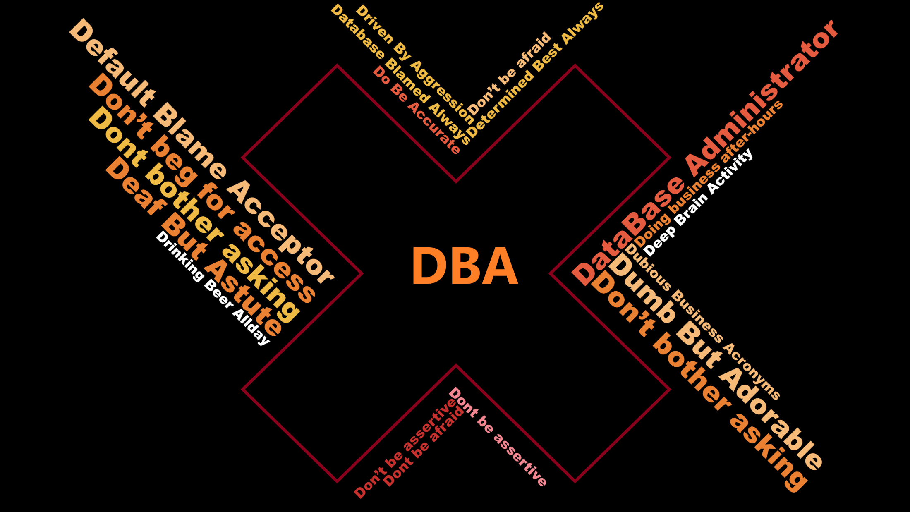
Notes:
OBS:SpeakerCentreSquare

Slide 8
Notes:
OBS:SpeakerCentreSquare

Slide 9
Backup
and
Restore
Common DBA Tasks
Agent Jobs
Security
Notes:
:SpeakerCentreSquareBottom

Slide 10
Backup
and
Restore
Common DBA Tasks
Backup-DbaDatabase
Get-DbaDbBackupHistory
Get-DbaBackupInformation
Get-DbaDbRestoreHistory
Get-DbaLastBackup
Measure-DbaBackupThroughput
Read-DbaBackupHeader
Restore-DbaDatabase
Test-DbaLastBackup
Agent Jobs
Get-DbaAgentJobHistory
Get-DbaAgentLog
Get-DbaRunningJob
New-DbaAgentJob
New-DbaAgentSchedule
Set-DbaAgentAlert
Remove-DbaAgentJob
Start-DbaAgentJob
Test-DbaAgentJobOwner
Security
Add-DbaDbRoleMember
Find-DbaLoginInGroup
Get-DbaDbRoleMember
Get-DbaDbOrphanUser
New-DbaLogin
Remove-DbaDbUser
Repair-DbaDbOrphanUser
Set-DbaLogin
Sync-DbaLoginPermission
Test-DbaWindowsLogin
Notes:
OBS:SpeakerCentreSquareBottom

Slide 11
Add-DbaAgDatabase
Add-DbaAgListener
Add-DbaAgReplica
Add-DbaComputerCertificate
Add-DbaDbMirrorMonitor
Add-DbaDbRoleMember
Add-DbaPfDataCollectorCounter
Add-DbaRegServer
Add-DbaRegServerGroup
Add-DbaServerRoleMember
Backup-DbaComputerCertificate
Backup-DbaDatabase
Backup-DbaDbCertificate
Backup-DbaDbMasterKey
Backup-DbaServiceMasterKey
Clear-DbaConnectionPool
Clear-DbaLatchStatistics
Clear-DbaPlanCache
Clear-DbaWaitStatistics
Connect-DbaInstance
ConvertTo-DbaDataTable
ConvertTo-DbaTimeline
ConvertTo-DbaXESession
Copy-DbaAgentAlert
Copy-DbaAgentJob
Copy-DbaAgentJobCategory
Copy-DbaAgentOperator
Copy-DbaAgentProxy
Copy-DbaAgentSchedule
Copy-DbaAgentServer
Copy-DbaBackupDevice
Copy-DbaCredential
Copy-DbaCustomError
Copy-DbaDatabase
Copy-DbaDbAssembly
Copy-DbaDbMail
Copy-DbaDbQueryStoreOption
Copy-DbaDbTableData
Copy-DbaDbViewData
Copy-DbaEndpoint
Copy-DbaInstanceAudit
Copy-DbaInstanceAuditSpecification
Copy-DbaInstanceTrigger
Copy-DbaLinkedServer
Copy-DbaLogin
Copy-DbaRegServer
Copy-DbaResourceGovernor
Copy-DbaSpConfigure
Copy-DbaStartupProcedure
Copy-DbaSysDbUserObject
Copy-DbaXESession
Copy-DbaXESessionTemplate
Disable-DbaAgHadr
Disable-DbaFilestream
Disable-DbaForceNetworkEncryption
Disable-DbaHideInstance
Disable-DbaStartupProcedure
Disable-DbaTraceFlag
Dismount-DbaDatabase
Enable-DbaAgHadr
Enable-DbaFilestream
Enable-DbaForceNetworkEncryption
Enable-DbaHideInstance
Enable-DbaStartupProcedure
Enable-DbaTraceFlag
Expand-DbaDbLogFile
Export-DbaCredential
Export-DbaDacPackage
Export-DbaDbRole
Export-DbaDbTableData
Export-DbaDiagnosticQuery
Export-DbaExecutionPlan
Export-DbaInstance
Export-DbaLinkedServer
Export-DbaLogin
Export-DbaPfDataCollectorSetTemplate
Export-DbaRegServer
Export-DbaScript
Export-DbaServerRole
Export-DbaSpConfigure
Export-DbatoolsConfig
Export-DbaXECsv
Export-DbaXESession
Export-DbaXESessionTemplate
Find-DbaAgentJob
Find-DbaBackup
Find-DbaCommand
Find-DbaDatabase
Find-DbaDbDisabledIndex
Find-DbaDbDuplicateIndex
Find-DbaDbGrowthEvent
Find-DbaDbUnusedIndex
Find-DbaInstance
Find-DbaLoginInGroup
Find-DbaOrphanedFile
Find-DbaSimilarTable
Find-DbaStoredProcedure
Find-DbaTrigger
Find-DbaUserObject
Find-DbaView
Format-DbaBackupInformation
Get-DbaAgDatabase
Get-DbaAgentAlert
Get-DbaAgentAlertCategory
Get-DbaAgentJob
Get-DbaAgentJobCategory
Get-DbaAgentJobHistory
Get-DbaAgentJobOutputFile
Get-DbaAgentJobStep
Get-DbaAgentLog
Get-DbaAgentOperator
Get-DbaAgentProxy
Get-DbaAgentSchedule
Get-DbaAgentServer
Get-DbaAgHadr
Get-DbaAgListener
Get-DbaAgReplica
Get-DbaAvailabilityGroup
Get-DbaAvailableCollation
Get-DbaBackupDevice
Get-DbaBackupInformation
Get-DbaBuildReference
Get-DbaClientAlias
Get-DbaClientProtocol
Get-DbaCmConnection
Get-DbaCmObject
Get-DbaComputerCertificate
Get-DbaComputerSystem
Get-DbaConnection
Get-DbaCpuRingBuffer
Get-DbaCpuUsage
Get-DbaCredential
Get-DbaCustomError
Get-DbaDatabase
Get-DbaDbAssembly
Get-DbaDbAsymmetricKey
Get-DbaDbBackupHistory
Get-DbaDbccHelp
Get-DbaDbccMemoryStatus
Get-DbaDbccProcCache
Get-DbaDbccSessionBuffer
Get-DbaDbccStatistic
Get-DbaDbccUserOption
Get-DbaDbCertificate
Get-DbaDbCheckConstraint
Get-DbaDbCompatibility
Get-DbaDbCompression
Get-DbaDbDbccOpenTran
Get-DbaDbDetachedFileInfo
Get-DbaDbEncryption
Get-DbaDbExtentDiff
Get-DbaDbFeatureUsage
Get-DbaDbFile
Get-DbaDbFileGroup
Get-DbaDbForeignKey
Get-DbaDbIdentity
Get-DbaDbLogShipError
Get-DbaDbLogSpace
Get-DbaDbMail
Get-DbaDbMailAccount
Get-DbaDbMailConfig
Get-DbaDbMailHistory
Get-DbaDbMailLog
Get-DbaDbMailProfile
Get-DbaDbMailServer
Get-DbaDbMasterKey
Get-DbaDbMemoryUsage
Get-DbaDbMirror
Get-DbaDbMirrorMonitor
Get-DbaDbObjectTrigger
Get-DbaDbOrphanUser
Get-DbaDbPageInfo
Get-DbaDbPartitionFunction
Get-DbaDbPartitionScheme
Get-DbaDbQueryStoreOption
Get-DbaDbRecoveryModel
Get-DbaDbRestoreHistory
Get-DbaDbRole
Get-DbaDbRoleMember
Get-DbaDbSharePoint
Get-DbaDbSnapshot
Get-DbaDbSpace
Get-DbaDbState
Get-DbaDbStoredProcedure
Get-DbaDbTable
Get-DbaDbTrigger
Get-DbaDbUdf
Get-DbaDbUser
Get-DbaDbView
Get-DbaDbVirtualLogFile
Get-DbaDefaultPath
Get-DbaDependency
Get-DbaDeprecatedFeature
Get-DbaDiskSpace
Get-DbaDump
Get-DbaEndpoint
Get-DbaErrorLog
Get-DbaErrorLogConfig
Get-DbaEstimatedCompletionTime
Get-DbaExecutionPlan
Get-DbaExtendedProtection
Get-DbaFeature
Get-DbaFile
Get-DbaFilestream
Get-DbaForceNetworkEncryption
Get-DbaHelpIndex
Get-DbaHideInstance
Get-DbaInstanceAudit
Get-DbaInstanceAuditSpecification
Get-DbaInstanceInstallDate
Get-DbaInstanceProperty
Get-DbaInstanceProtocol
Get-DbaInstanceTrigger
Get-DbaInstanceUserOption
Get-DbaIoLatency
Get-DbaKbUpdate
Get-DbaLastBackup
Get-DbaLastGoodCheckDb
Get-DbaLatchStatistic
Get-DbaLinkedServer
Get-DbaLocaleSetting
Get-DbaLogin
Get-DbaMaintenanceSolutionLog
Get-DbaManagementObject
Get-DbaMaxMemory
Get-DbaMemoryCondition
Get-DbaMemoryUsage
Get-DbaModule
Get-DbaMsdtc
Get-DbaNetworkActivity
Get-DbaNetworkCertificate
Get-DbaOpenTransaction
Get-DbaOperatingSystem
Get-DbaPageFileSetting
Get-DbaPermission
Get-DbaPfAvailableCounter
Get-DbaPfDataCollector
Get-DbaPfDataCollectorCounter
Get-DbaPfDataCollectorCounterSample
Get-DbaPfDataCollectorSet
Get-DbaPfDataCollectorSetTemplate
Get-DbaPlanCache
Get-DbaPowerPlan
Get-DbaPrivilege
Get-DbaProcess
Get-DbaProductKey
Get-DbaQueryExecutionTime
Get-DbaRandomizedDataset
Get-DbaRandomizedDatasetTemplate
Get-DbaRandomizedType
Get-DbaRandomizedValue
Get-DbaRegistryRoot
Get-DbaRegServer
Get-DbaRegServerGroup
Get-DbaRegServerStore
Get-DbaResourceGovernor
Get-DbaRgClassifierFunction
Get-DbaRgResourcePool
Get-DbaRgWorkloadGroup
Get-DbaRunningJob
Get-DbaSchemaChangeHistory
Get-DbaServerRole
Get-DbaServerRoleMember
Common DBA Tasks
Get-DbaService
Get-DbaSpConfigure
Get-DbaSpinLockStatistic
Get-DbaSpn
Get-DbaStartupParameter
Get-DbaStartupProcedure
Get-DbaSuspectPage
Get-DbaTcpPort
Get-DbaTempdbUsage
Get-DbatoolsChangeLog
Get-DbatoolsConfig
Get-DbatoolsConfigValue
Get-DbatoolsLog
Get-DbatoolsPath
Get-DbaTopResourceUsage
Get-DbaTrace
Get-DbaTraceFlag
Get-DbaUptime
Get-DbaUserPermission
Get-DbaWaitingTask
Get-DbaWaitResource
Get-DbaWaitStatistic
Get-DbaWindowsLog
Get-DbaWsfcAvailableDisk
Get-DbaWsfcCluster
Get-DbaWsfcDisk
Get-DbaWsfcNetwork
Get-DbaWsfcNetworkInterface
Get-DbaWsfcNode
Get-DbaWsfcResource
Get-DbaWsfcResourceType
Get-DbaWsfcRole
Get-DbaWsfcSharedVolume
Get-DbaXEObject
Get-DbaXESession
Get-DbaXESessionTarget
Get-DbaXESessionTargetFile
Get-DbaXESessionTemplate
Get-DbaXESmartTarget
Get-DbaXEStore
Grant-DbaAgPermission
Import-DbaCsv
Import-DbaPfDataCollectorSetTemplate
Import-DbaRegServer
Import-DbaSpConfigure
Import-DbatoolsConfig
Import-DbaXESessionTemplate
Install-DbaFirstResponderKit
Install-DbaInstance
Install-DbaMaintenanceSolution
Install-DbaSqlWatch
Install-DbatoolsWatchUpdate
Install-DbaWhoIsActive
Invoke-DbaAdvancedInstall
Invoke-DbaAdvancedRestore
Invoke-DbaAdvancedUpdate
Invoke-DbaAgFailover
Invoke-DbaBalanceDataFiles
Invoke-DbaCycleErrorLog
Invoke-DbaDbccDropCleanBuffer
Invoke-DbaDbccFreeCache
Invoke-DbaDbClone
Invoke-DbaDbDataGenerator
Invoke-DbaDbDataMasking
Invoke-DbaDbDbccCheckConstraint
Invoke-DbaDbDbccCleanTable
Invoke-DbaDbDbccUpdateUsage
Invoke-DbaDbDecryptObject
Invoke-DbaDbLogShipping
Invoke-DbaDbLogShipRecovery
Invoke-DbaDbMirrorFailover
Invoke-DbaDbMirroring
Invoke-DbaDbPiiScan
Invoke-DbaDbShrink
Invoke-DbaDbTransfer
Invoke-DbaDbUpgrade
Invoke-DbaDiagnosticQuery
Invoke-DbaPfRelog
Invoke-DbaQuery
Invoke-DbatoolsFormatter
Invoke-DbatoolsRenameHelper
Invoke-DbaWhoIsActive
Invoke-DbaXEReplay
Join-DbaAvailabilityGroup
Join-DbaPath
Measure-DbaBackupThroughput
Measure-DbaDbVirtualLogFile
Measure-DbaDiskSpaceRequirement
Measure-DbatoolsImport
Mount-DbaDatabase
Move-DbaRegServer
Move-DbaRegServerGroup
New-DbaAgentAlertCategory
New-DbaAgentJob
New-DbaAgentJobCategory
New-DbaAgentJobStep
New-DbaAgentProxy
New-DbaAgentSchedule
New-DbaAvailabilityGroup
New-DbaAzAccessToken
New-DbaClientAlias
New-DbaCmConnection
New-DbaComputerCertificate
New-DbaComputerCertificateSigningRequest
New-DbaConnectionString
New-DbaConnectionStringBuilder
New-DbaCredential
New-DbaDacOption
New-DbaDacProfile
New-DbaDatabase
New-DbaDbAsymmetricKey
New-DbaDbCertificate
New-DbaDbDataGeneratorConfig
New-DbaDbMailAccount
New-DbaDbMailProfile
New-DbaDbMaskingConfig
New-DbaDbMasterKey
New-DbaDbRole
New-DbaDbSnapshot
New-DbaDbTable
New-DbaDbTransfer
New-DbaDbUser
New-DbaDiagnosticAdsNotebook
New-DbaDirectory
New-DbaEndpoint
New-DbaLogin
New-DbaScriptingOption
New-DbaServerRole
New-DbaServiceMasterKey
New-DbatoolsSupportPackage
New-DbaXESession
New-DbaXESmartCsvWriter
New-DbaXESmartEmail
New-DbaXESmartQueryExec
New-DbaXESmartReplay
New-DbaXESmartTableWriter
Publish-DbaDacPackage
Read-DbaAuditFile
Read-DbaBackupHeader
Read-DbaTraceFile
Read-DbaTransactionLog
Read-DbaXEFile
Register-DbatoolsConfig
Remove-DbaAgDatabase
Remove-DbaAgentAlertCategory
Remove-DbaAgentJob
Remove-DbaAgentJobCategory
Remove-DbaAgentJobStep
Remove-DbaAgentSchedule
Remove-DbaAgListener
Remove-DbaAgReplica
Remove-DbaAvailabilityGroup
Remove-DbaBackup
Remove-DbaClientAlias
Remove-DbaCmConnection
Remove-DbaComputerCertificate
Remove-DbaDatabase
Remove-DbaDatabaseSafely
Remove-DbaDbAsymmetricKey
Remove-DbaDbBackupRestoreHistory
Remove-DbaDbCertificate
Remove-DbaDbLogShipping
Remove-DbaDbMasterKey
Remove-DbaDbMirror
Remove-DbaDbMirrorMonitor
Remove-DbaDbOrphanUser
Remove-DbaDbRole
Remove-DbaDbRoleMember
Remove-DbaDbSnapshot
Remove-DbaDbUser
Remove-DbaEndpoint
Remove-DbaLogin
Remove-DbaNetworkCertificate
Remove-DbaPfDataCollectorCounter
Remove-DbaPfDataCollectorSet
Remove-DbaRegServer
Remove-DbaRegServerGroup
Remove-DbaServerRole
Remove-DbaSpn
Remove-DbaTrace
Remove-DbaXESession
Remove-DbaXESmartTarget
Rename-DbaDatabase
Rename-DbaLogin
Repair-DbaDbMirror
Repair-DbaDbOrphanUser
Repair-DbaInstanceName
Reset-DbaAdmin
Reset-DbatoolsConfig
Resolve-DbaNetworkName
Resolve-DbaPath
Restart-DbaService
Restore-DbaDatabase
Restore-DbaDbCertificate
Restore-DbaDbSnapshot
Resume-DbaAgDbDataMovement
Revoke-DbaAgPermission
Save-DbaDiagnosticQueryScript
Save-DbaKbUpdate
Select-DbaBackupInformation
Set-DbaAgentAlert
Set-DbaAgentJob
Set-DbaAgentJobCategory
Set-DbaAgentJobOutputFile
Set-DbaAgentJobOwner
Set-DbaAgentJobStep
Set-DbaAgentSchedule
Set-DbaAgentServer
Set-DbaAgListener
Set-DbaAgReplica
Set-DbaAvailabilityGroup
Set-DbaCmConnection
Set-DbaDbCompatibility
Set-DbaDbCompression
Set-DbaDbIdentity
Set-DbaDbMirror
Set-DbaDbOwner
Set-DbaDbQueryStoreOption
Set-DbaDbRecoveryModel
Set-DbaDbState
Set-DbaEndpoint
Set-DbaErrorLogConfig
Set-DbaExtendedProtection
Set-DbaLogin
Set-DbaMaxDop
Set-DbaMaxMemory
Set-DbaNetworkCertificate
Set-DbaPowerPlan
Set-DbaPrivilege
Set-DbaSpConfigure
Set-DbaSpn
Set-DbaStartupParameter
Set-DbaTcpPort
Set-DbaTempDbConfig
Set-DbatoolsPath
Show-DbaDbList
Show-DbaInstanceFileSystem
Start-DbaAgentJob
Start-DbaEndpoint
Start-DbaMigration
Start-DbaPfDataCollectorSet
Start-DbaService
Start-DbaTrace
Start-DbaXESession
Start-DbaXESmartTarget
Stop-DbaAgentJob
Stop-DbaEndpoint
Stop-DbaPfDataCollectorSet
Stop-DbaProcess
Stop-DbaService
Stop-DbaTrace
Stop-DbaXESession
Stop-DbaXESmartTarget
Suspend-DbaAgDbDataMovement
Sync-DbaAvailabilityGroup
Sync-DbaLoginPermission
Test-DbaAgentJobOwner
Test-DbaBackupInformation
Test-DbaBuild
Test-DbaCmConnection
Test-DbaConnection
Test-DbaConnectionAuthScheme
Test-DbaDbCollation
Test-DbaDbCompatibility
Test-DbaDbCompression
Test-DbaDbDataGeneratorConfig
Test-DbaDbDataMaskingConfig
Test-DbaDbLogShipStatus
Test-DbaDbOwner
Test-DbaDbRecoveryModel
Test-DbaDeprecatedFeature
Test-DbaDiskAlignment
Test-DbaDiskAllocation
Test-DbaDiskSpeed
Test-DbaEndpoint
Test-DbaIdentityUsage
Test-DbaInstanceName
Test-DbaLastBackup
Test-DbaLinkedServerConnection
Test-DbaLoginPassword
Test-DbaManagementObject
Test-DbaMaxDop
Test-DbaMaxMemory
Test-DbaMigrationConstraint
Test-DbaNetworkLatency
Test-DbaOptimizeForAdHoc
Test-DbaPath
Test-DbaPowerPlan
Test-DbaSpn
Test-DbaTempDbConfig
Test-DbaWindowsLogin
Uninstall-DbaSqlWatch
Uninstall-DbatoolsWatchUpdate
Unregister-DbatoolsConfig
Update-DbaInstance
Update-DbaServiceAccount
Update-Dbatools
Watch-DbaDbLogin
Watch-DbatoolsUpdate
Watch-DbaXESession
Write-DbaDbTableData
Notes:
OBS:SpeakerCentreSquareBottom

Slide 12
Demo
Notes:
OBS:SpeakerBigRightAllLeft

Slide 14
Backup
and
Restore
Common DBA Tasks
Backup-DbaDatabase
Get-DbaDbBackupHistory
Get-DbaBackupInformation
Get-DbaDbRestoreHistory
Get-DbaLastBackup
Measure-DbaBackupThroughput
Read-DbaBackupHeader
Restore-DbaDatabase
Test-DbaLastBackup
Agent Jobs
Get-DbaAgentJobHistory
Get-DbaAgentLog
Get-DbaRunningJob
New-DbaAgentJob
New-DbaAgentSchedule
Set-DbaAgentAlert
Remove-DbaAgentJob
Start-DbaAgentJob
Test-DbaAgentJobOwner
Security
Add-DbaDbRoleMember
Find-DbaLoginInGroup
Get-DbaDbRoleMember
Get-DbaDbOrphanUser
New-DbaLogin
Remove-DbaDbUser
Repair-DbaDbOrphanUser
Set-DbaLogin
Sync-DbaLoginPermission
Test-DbaWindowsLogin
Notes:
OBS:SpeakerCentreSquareBottom

Slide 15
Common DBA Tasks
Notes:
OBS:SpeakerCentreSquare

Slide 16

Accelerate 2020 Brand
Copy/paste logo art for use in digital presentations
Primary event logo
Official descriptor/tagline
Virtual Conference for data professionals

Slide 17
Branded Merch

